Slide 1
Travel agent
CAPSTONE PROJECT
Presented By: A vision agent
Student name : Rubini T
College Name & Department : Achariya College of Engineering Technology & B.tech Artificial intelligence and data science

Slide 2
OUTLINE
Problem Statement
Technology used
Wow factor
End users
Result
Conclusion
Future scope
IBM certifications

Slide 3
Problem Statement
A Travel Planner Agent is an AI-powered assistant that helps users plan trips efficiently and intelligently. It uses real-time data to suggest destinations, build itineraries, and recommend transport and accommodation options. By understanding user preferences, budgets, and constraints, it tailors personalized travel plans. Integrated with maps, weather updates, and local guides, it ensures a smooth travel experience.The agent can also manage bookings, alert users to changes, and optimize schedules on the go. This smart assistant transforms complex travel planning into a seamless, enjoyable process

Slide 4
Proposed solution:
The AI-powered Travel Planner Agent uses real-time data and user preferences to generate personalized travel plans. It recommends destinations, builds custom itineraries, and suggests transport and accommodation options. Integrated with maps, weather updates, and booking systems, it ensures a smooth and optimized travel experience. The agent also sends alerts, manages bookings, and adjusts schedules dynamically, transforming complex travel planning into a simple, intelligent, and enjoyable process.

Slide 5
Technology used
IBM cloud lite services
Natural Language Processing (NLP)
Retrieval Augmented Generation (RAG)
IBM Granite model

Slide 6
IBM cloud services used
IBM Cloud Watsonx AI Studio
IBM Cloud watsonx AI runtime
IBM Cloud Agent Lab
IBM Granite foundation model

Slide 7
Wow factors
Personalized itineraries based on user preferences.
Real-time suggestions for destinations, weather, and events.
Auto itinerary updates for delays or changes
All-in-one booking for flights, hotels, and activities.
Live maps and local guide tips for smooth navigation.
Instant travel alerts and notifications.
Learns user habits for smarter future plans.
Multilingual and global support.
Stress-free, fast planning.
Inclusive for all types of travelers.

Slide 8
End users
Academic Researchers
Research Institutions and Universities
Industry R&D Teams
Educators

Slide 9
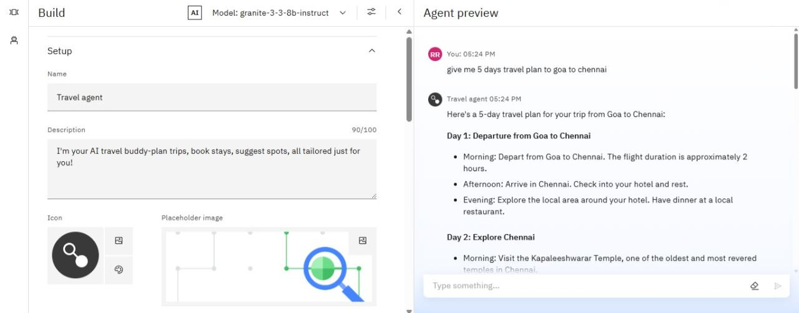
Results

Slide 10
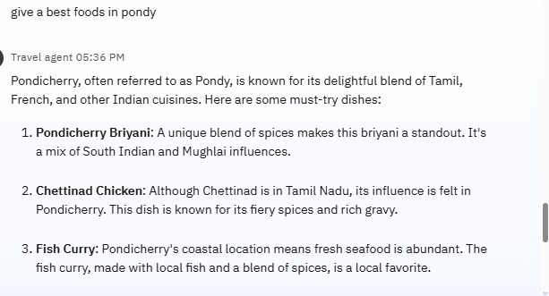
Results

Slide 11
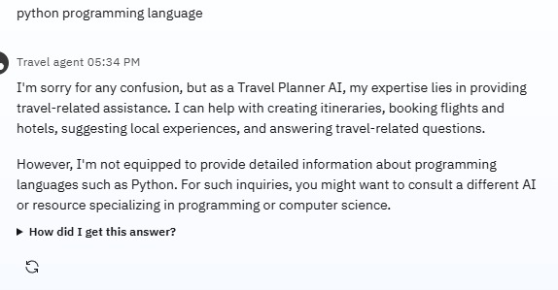
Results

Slide 12
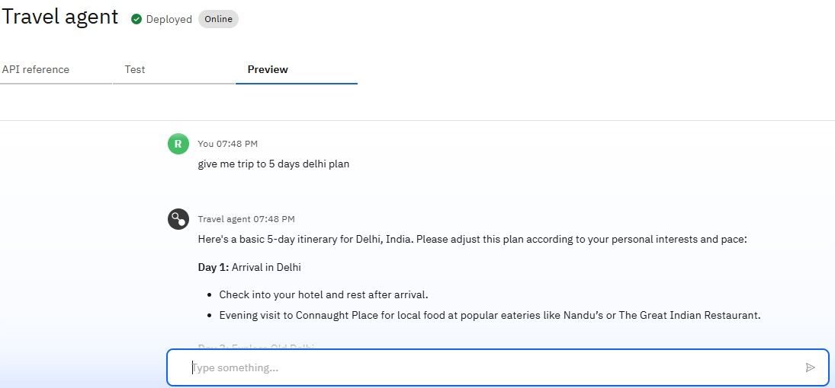
Results
Deployed AI Agent

Slide 13
Conclusion
The AI-powered Travel Planner Agent revolutionizes the way people plan their trips by offering a smart, personalized, and real-time travel experience. It simplifies complex planning tasks—like booking, itinerary creation, and updates—into a seamless process tailored to each user’s needs. By integrating live data, intelligent recommendations, and automation, the agent ensures a hassle-free, enjoyable, and inclusive travel journey for everyone.

Slide 14
Future scope
Voice-based trip planning.
AR/VR virtual destination previews.
Smart AI chat support during travel.
Eco-friendly travel suggestions.
Offline and multilingual assistance.
Group trip planning tools.
Integration with local services.
Secure bookings via blockchain.
Health and safety alerts.
Smarter predictions using AI learning.

Slide 15
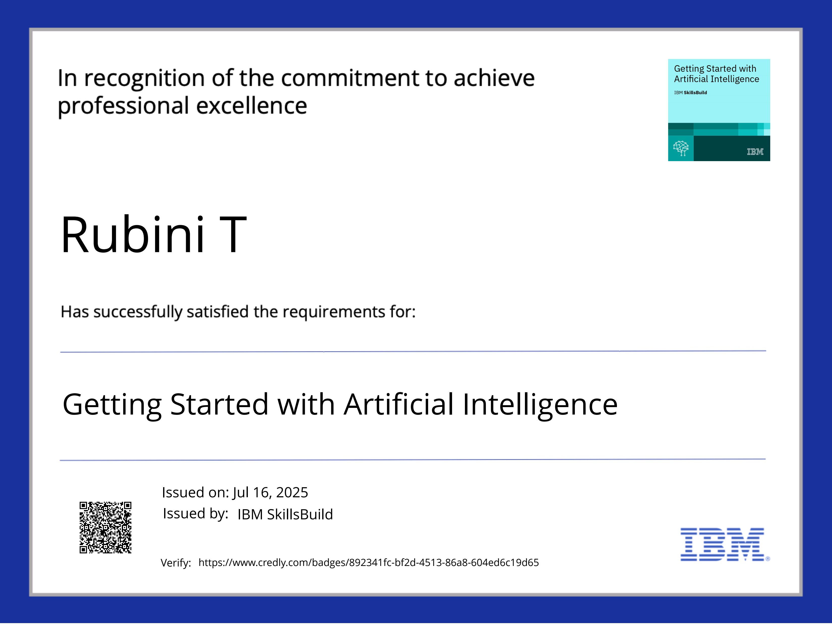
Ibm certifications.

Slide 16
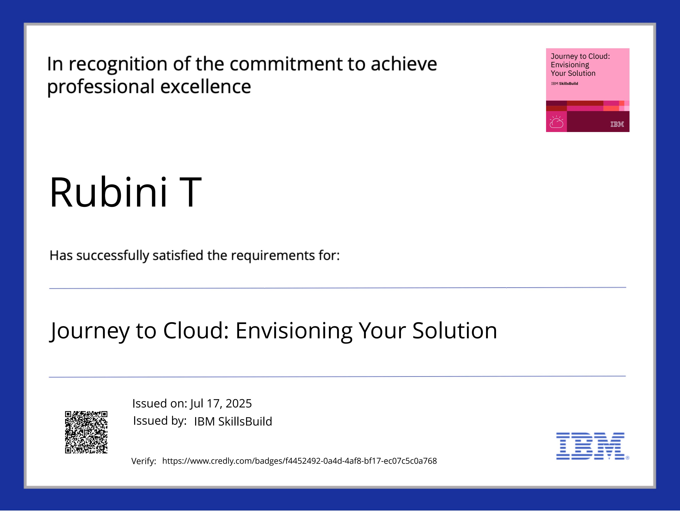
Ibm certifications

Slide 17
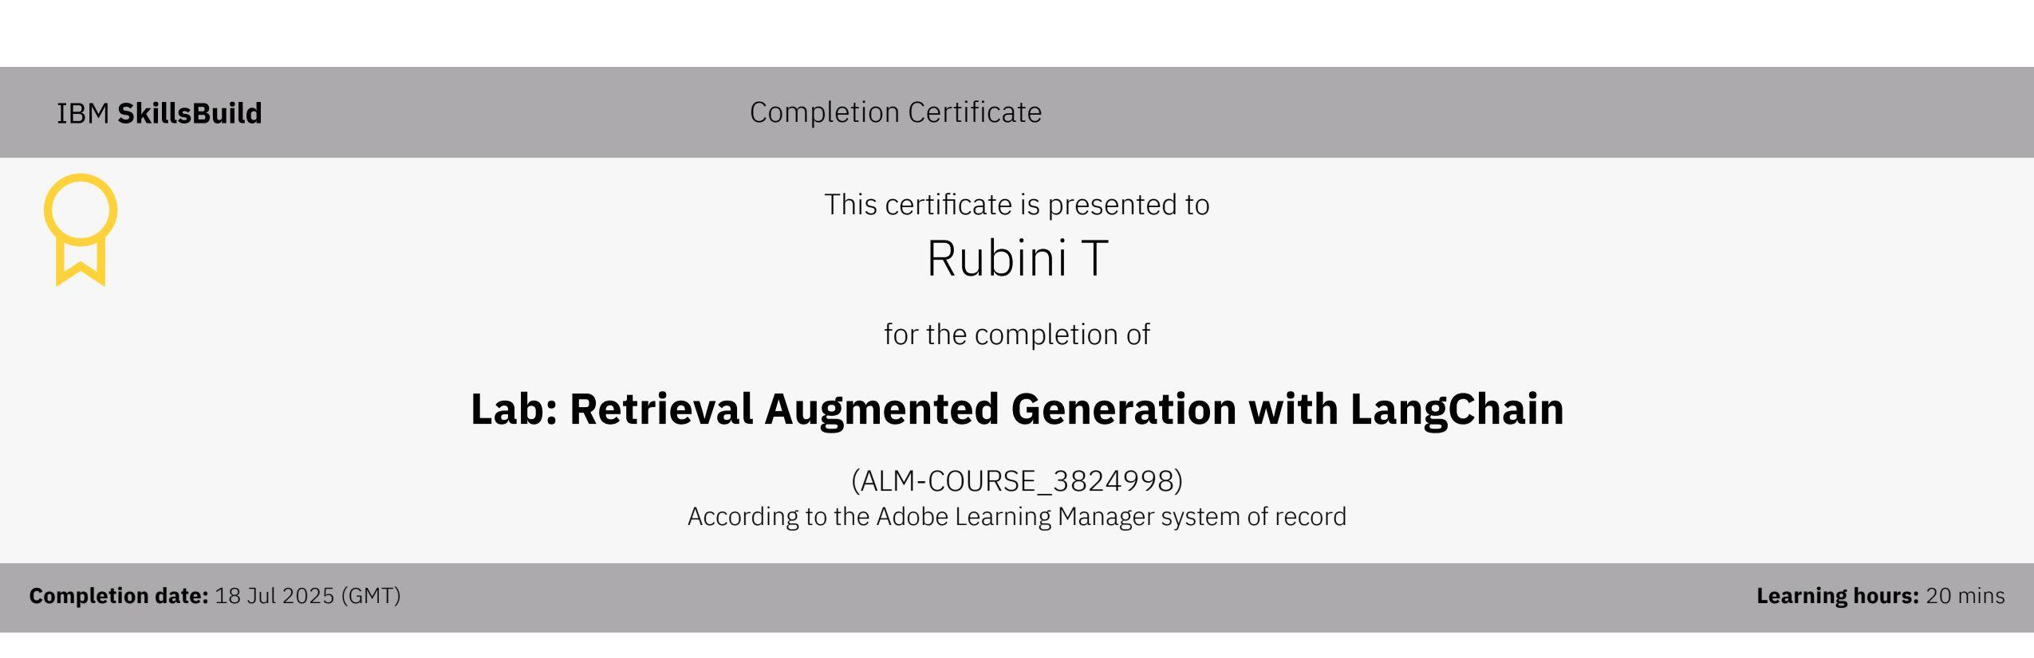
Attach your RAG LAB certificate here

Slide 18
Thank you

